Slide 1

Learning from positive and unlabeled data: a survey
Fiche de lecture , Vincent, December 2019

Slide 2
1 Introduction
This survey is structured around giving a comprehensive overview about how the PU learning research community is tackling each of these questions :
1. How can we formalize the problem of learning from PU data?
2. What assumptions are typically made about PU data in order to facilitate the design of learning algorithms?
3. Can we estimate the class prior from PU data and why is this useful?
4. How can we learn a model from PU data?
5. How can we evaluate models in a PU setting?
6. When and why does PU data arise in real-world applications?
7. How does PU learning relate to other areas of machine learning?
The first author defended her PhD at the end of 2018.
List of Abbreviations (used):
MAE: Mean Absolute Error, MSE: Mean Square Error,
NU: Negative and Unlabeled, PU: Positive and Unlabeled, PU learning: Learning from positive and unlabeled data,
SAR: Selected At Random, SCAR: Selected Completely At Random, SNAR: Selected Not At Random
The paper concludes with some perspectives about future directions for PU learning research

Slide 3
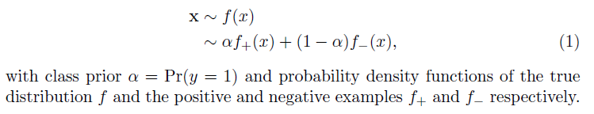
2 Preliminaries on PU Learning
Learning from positive and unlabeled data (PU learning) is a special case of binary classification. Therefore, we first review binary classification before formally describing the PU learning setting…
2.1 Binary Classfication
To enable training a correct classifier, the training data is assumed to be an independent and identically distributed (i.i.d.) sample of the real distribution
2.2 PU Learning

Slide 4
2 Preliminaries on PU Learning
2.1 Binary Classification
2.2 PU Learning
2.3 Labeling Mechanism
2.4 The Single-Training-Set and Case-Control Scenarios
2.5 Relationship Between the Class Prior and the Label Frequency

Slide 5
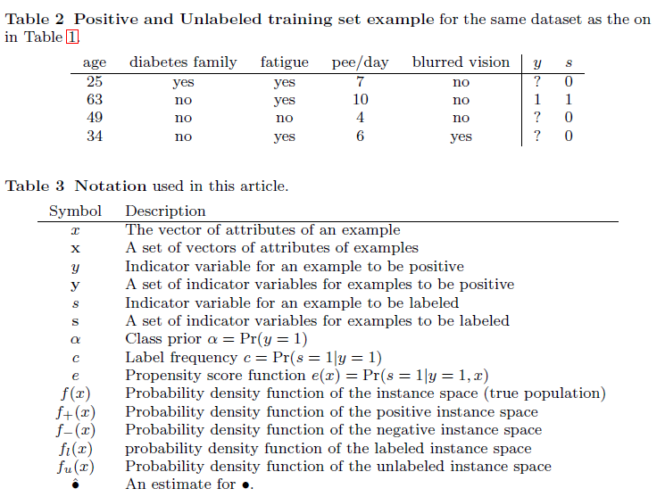
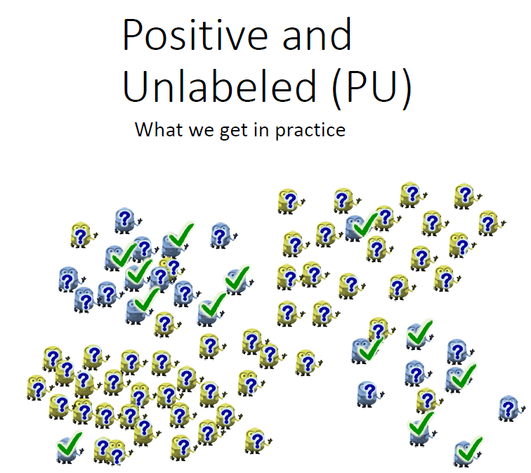
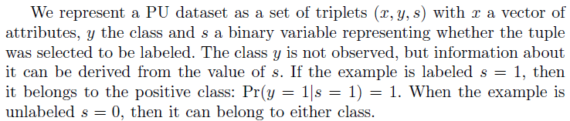
2 Preliminaries on PU Learning
2.2 PU Learning

Slide 6

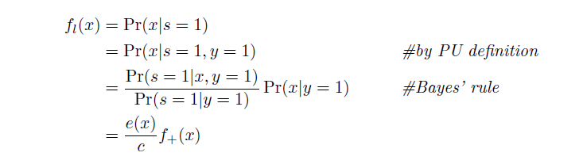
2 Preliminaries on PU Learning
2.3 Labeling Mechanism
The labeled positive examples are selected from the complete set of positive examples according to a probabilistic labeling mechanism, where each positive example x has the probability e(x) = Pr(s = 1|y = 1; x) of being selected to be labeled, called the propensity score [2]. Hence, the labeled distribution is a biased version of the positive distribution:
with fl(x) and f+(x) the probability density functions of the labeled and positive distributions respectively. The normalization constant c is the label frequency, which is the fraction of positive examples that are labeled c = Pr(s = 1 | y = 1). This can be seen from the following derivation

Slide 7
2 Preliminaries on PU Learning
2.4 The Single-Training-Set and Case-Control Scenarios
2.5 Relationship Between the Class Prior and the Label Frequency

Slide 8
3 Assumptions to Enable PU Learning
3.1 Label Mechanism Assumptions
3.1.1 Selected Completely At Random
3.1.2 Selected At Random
3.1.3 Probabilistic Gap
3.2 Data Assumptions
3.2.1 Negativity
3.2.2 Separability
3.2.3 Smoothness
3.3 Assumptions for an Identifiable Class Prior
3.3.1. Separable Classes/Non-overlapping distributions
3.3.2. Positive subdomain/anchor set
3.3.3. Positive function/separability …
3.3.4. Irreducibility ...

Slide 9
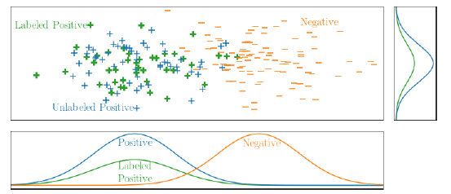


3 Assumptions to Enable PU Learning
Learning from PU data is not straightforward. There are two possibilities to explain why an example is unlabeled, either:
1. It is truly a negative example; or
2. It is a positive example, but simply was not selected by the labeling mechanism to have its label observed.
Therefore, in order to enable learning with positive and unlabeled data, it is necessary to make assumptions about either the labeling mechanism, the class distributions in the data, or both. The class prior plays an important role in PU learning and many PU learning methods require it as an input.
3.1 Label Mechanism Assumptions
3.1.1 Selected Completely At Random
Utiliser MODL pour prédire P(s=1|x) et corriger?
Zhang, D., Lee, W.S.: A simple probabilistic approach to learning from positive and unlabeled examples. In: Proceedings of the fifth Annual UK Workshop on Computational Intelligence (UKCI), pp. 83{87 (2005)

Slide 10
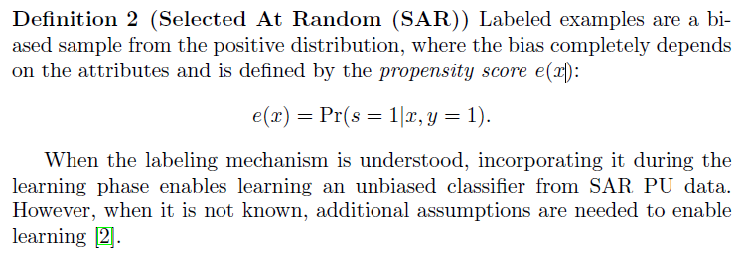
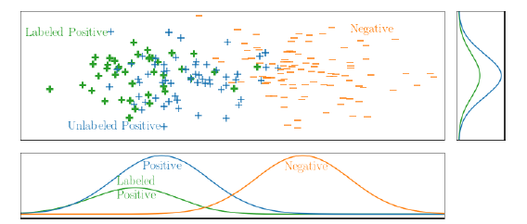
3 Assumptions to Enable PU Learning
3 Assumptions to Enable PU Learning
3.1 Label Mechanism Assumptions
3.1.2 Selected At Random
Utiliser MODL pour prédire P(s=1|x), faire l’hypothèse que par morceau
Sur X on est “Selected Complety at Random” et corriger par un ‘c’ dont la
valeur depend de l’intervalle où on est ?
Regarder s’il existe un article PUL avec decision tree ? Et du coup aurait penser à faire cela ?

Slide 11
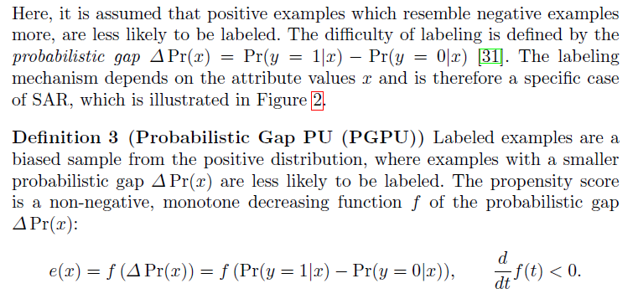
3 Assumptions to Enable PU Learning
3 Assumptions to Enable PU Learning
3.1 Label Mechanism Assumptions
3.1.3 Probabilistic Gap
Voir :
“He, F., Liu, T., Webb, G.I., Tao, D.:
Instance-dependent pu learning by bayesian optimal relabeling”.
arXiv preprint arXiv:1808.02180 (2018)”
Methode d’étiquetage basée sur la propagation d’étiquette ?
Propager l’étiquetage avant de faire la correction ?

Slide 12
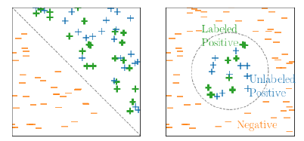
3 Assumptions to Enable PU Learning
3 Assumptions to Enable PU Learning
3.2 Data Assumptions
The common assumptions about the data distribution are that all unlabeled examples are negative, the classes are separable and the classes have a smooth distribution.
3.2.1 Negativity
The most simple, and most naive, assumption is to assume that the unlabeled examples all belong to the negative class. Despite the fact that this assumption obviously does not hold, it is often used in practice
3.2.2 Separability
Under the separability assumption, it is assumed that the two classes of interest are naturally separated. This means that a classifier exists that can perfectly distinguish positive from negative examples
Definition 4 (Separability) There exists a function f in the considered
hypothesis space that maps all the positive examples to a value that is higher
or equal to a threshold τ and all negative examples to a value that is lower
than threshold .
Under this assumption, the optimal classifier can be found by looking for
the classifier that classifies all labeled examples as positive and as few as
possible examples as negative [62, 5]. This idea is exploited by the two-step techniques (to see later)

Slide 13
3 Assumptions to Enable PU Learning
3 Assumptions to Enable PU Learning
3.2 Data Assumptions
3.2.3 Smoothness
According to the smoothness assumption, examples that are close to each other are more likely to have the same label.
Definition 5 (Smoothness) If two instances x1 and x2 are similar, then the probabilities Pr(y = 1|x1) and Pr(y = 1|x2) will also be similar.
This assumption allows identifying reliable negative examples as those that are far from all the labeled examples. This can be done by using different similarity (or distance) measures such as tf-idf for text [53] or DILCA for categorical attributes [37]. This assumption is important for two-step techniques (Section 5.1). It is also used for graph-based approaches [76,108], local learning
[43] and to cluster the data into super-instances where all the instances are assumed to have the same label [57].
Methode d’étiquetage basée sur la propagation d’étiquette ?
Propager l’étiquetage avant de faire la correction (S7, S8) ?

Slide 14
3 Assumptions to Enable PU Learning
3 Assumptions to Enable PU Learning
3.3 Assumptions for an Identifiable Class Prior
The class prior α= Pr(y = 1) can be an important tool for PU learning under the SCAR assumption.
Unfortunately, this is an ill-defined problem because it is not identifiable: the absence of a label can be explained by either a small prior probability for the positive class or a low label frequency [86]. In order for the class prior to be identifiable, additional assumption are necessary.
1. Separable Classes/Non-overlapping distributions
Here, the positive and negative distributions are assumed not to overlap [24,22,75]. The positive examples in the unlabeled data are then all those that are likely to be generated by the same distribution as the labeled examples. When all the unlabeled positive examples are identified, class prior estimation becomes trivial.
2. Positive subdomain/anchor set
To write and understand
3. Positive function/separability …
To write and understand
4. Irreducibility ...
To write and understand

Slide 15
3 Assumptions to Enable PU Learning
3.1 Label Mechanism Assumptions
3.1.1 Selected Completely At Random
3.1.2 Selected At Random
3.1.3 Probabilistic Gap
3.2 Data Assumptions
3.2.1 Negativity
3.2.2 Separability
3.2.3 Smoothness
3.3 Assumptions for an Identifiable Class Prior
3.3.1. Separable Classes/Non-overlapping distributions
3.3.2. Positive subdomain/anchor set
3.3.3. Positive function/separability …
3.3.4. Irreducibility ...

Slide 16
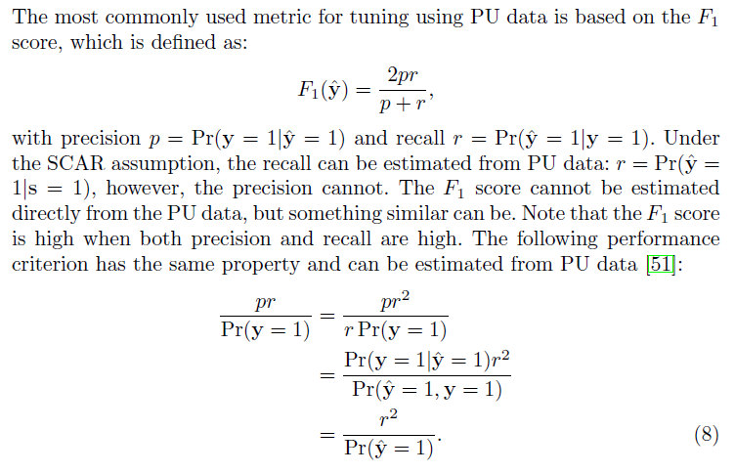
4 PU measures
It is non-obvious how to compute most standard evaluation metrics, such as accuracy, F1 score, mean square error, etc. from positive and unlabeled data. This introduces challenges both in terms of model evaluation and hyperparameter tuning. The first attempts for addressing this issue focused on proposing metrics that could be computed based on the total number of examples and the number of positive examples. More recent work has explored hypothesis testing and situations where it may be possible to compute standard metrics.
4.1 Metrics for PU Data
See on the right
4.2 Hypothesis Testing
To write
4.3 Computing Standard Evaluation Metrics
To write and a link with MODL

Slide 17
5 PU Learning Methods
This section provides an overview of the methods that address PU learning. Most methods can be divided into the following three categories:
* Two-step techniques,
* biased learning and
* class prior incorporation.
The two-step technique consists of two steps: 1) identifying reliable negative examples, and 2) learning based on the labeled positives and reliable negatives.
Biased learning considers PU data as fully labeled data with class label noise for the negative class.
Class prior incorporation modifies standard learning methods by applying the mathematics from the SCAR assumption directly, using the provided class prior.
Additionally, methods for learning from relational PU data are discussed.
5.1 Two-Step Techniques
5.2 Biased Learning
5.2.1 Classification
5.2.2 Clustering
5.2.3 Matrix Completion
5.3 Incorporation of the Class Prior

Slide 18
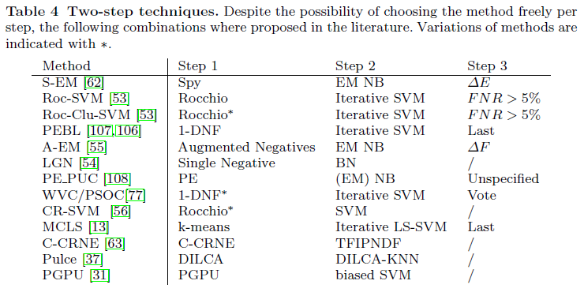
5 PU Learning Methods
5.1 Two-Step Techniques
The two-step technique builds on the assumptions of separability and smoothness. Because of this combination, it is assumed that all the positive examples are similar to the labeled examples and that the negative examples are very different from them. Based on this idea, the two-step technique consists of the following steps [61]:
Step 1 Identify reliable negative examples. Optionally, additional positive examples can also be generated [27].
Step 2 Use (semi-)supervised learning techniques with the positively labeled examples, reliable negatives, and, optionally, the remaining unlabeled examples.
Step 3 (when applicable) Select the best classifier generated in step 2.

Slide 19
5 PU Learning Methods
5.1 Two-Step Techniques
Step 1 Identify reliable negative examples. Optionally, additional positive examples can also be generated [27].
Step 2 Use (semi-)supervised learning techniques with the positively labeled examples, reliable negatives, and, optionally, the remaining unlabeled examples.
Step 3 (when applicable) Select the best classifier generated in step 2.
Identifying Reliable Negatives (and Positives) In the first step, unlabeled examples that are very different from the positive examples are selected as reliable negatives. Many methods have been proposed to address this problem. They differ from each other in the way distance is defined and when something is considered as different enough
Three Examples
‘Spy’: Some of the labeled examples are turned into spies by adding them to the unlabeled dataset. Then, a Naive Bayes classifier is trained, considering the unlabeled examples as negative, and updated once using expectation maximization. The reliable negative examples are all the unlabeled negative examples for which the posterior probability is lower than the posterior probability of any of the spies [62]. For this method, it is important to have enough labeled examples, otherwise the set of spies is too small and hence unreliable.
k-means: All the examples are clustered using k-means. Reliable negative examples are selected from the negative clusters as the furthest ones from the positive examples [13].
kNN: The unlabeled examples are ranked according to their distance to the k nearest positive examples. The unlabeled examples at the greatest distance are selected as reliable negatives.

Slide 20
5 PU Learning Methods
5.1 Two-Step Techniques
Step 1 Identify reliable negative examples. Optionally, additional positive examples can also be generated [27].
Step 2 Use (semi-)supervised learning techniques with the positively labeled examples, reliable negatives, and, optionally, the remaining unlabeled examples.
Step 3 (when applicable) Select the best classifier generated in step 2.
(Semi-)Supervised Learning : In the second step, the labeled positive examples and reliable negatives are used to train a classifier. Any supervised method, like support vector machines (SVM) or Naive Bayes (NB), can be used for this.
Apart from existing methods, a few custom methods for PU learning have been proposed
Examples
Iterative SVM: In each iteration, an SVM classifier is trained using the positive examples and the reliable negatives. The unlabeled examples that are classified as negative by this classifier are then added to the set of reliable negatives for the next iteration (sort of self learning).
KNN: For both the positive and reliable negative examples, a distance measure is trained [38]. For each example, the k nearest positives and k nearest reliable negatives are selected and the average distance to those are calculated with the appropriate distance measure. The class is the one for which it has the lowest average distance

Slide 21
5 PU Learning Methods
5.1 Two-Step Techniques
Step 1 Identify reliable negative examples. Optionally, additional positive examples can also be generated [27].
Step 2 Use (semi-)supervised learning techniques with the positively labeled examples, reliable negatives, and, optionally, the remaining unlabeled examples.
Step 3 (when applicable, optional) Select the best classifier generated in step 2.
Not detailed by me…

Slide 22
5 PU Learning Methods
5.1 Two-Step Techniques
5.2 Biased Learning
Biased PU learning methods treat the unlabeled examples as negatives examples with class label noise, therefore, this section refers to unlabeled examples as negative. Because the noise for negative examples is a constant, this setting makes the SCAR assumption. The noise is taken into account by, for example, placing higher penalties on misclassified positive examples or tuning hyperparameters based on an evaluation metric that is suitable for PU data.
Usually the misclassification penalties or other hyperparameters are chosen through tuning using Equation 8 [61,18,112,92] or another measure [93]. Alternatively, they are set based on the true class prior [36] or so that a balanced classifier is preferred [70, 51]. This approach has been applied to classification, clustering and matrix completion.
5.2.1 Classification
5.2.2 Clustering
5.2.3 Matrix Completion
5.3 Incorporation of the Class Prior

Slide 23
5 PU Learning Methods
5.1 Two-Step Techniques
5.2 Biased Learning
Biased PU learning methods treat the unlabeled examples as negatives examples with class label noise, therefore, this section refers to unlabeled examples as negative. Because the noise for negative examples is a constant, this setting makes the SCAR assumption. The noise is taken into account by, for example, placing higher penalties on misclassified positive examples or tuning hyperparameters based on an evaluation metric that is suitable for PU data.
Usually the misclassification penalties or other hyperparameters are chosen through tuning using Equation 8 [61,18,112,92] or another measure [93]. Alternatively, they are set based on the true class prior [36] or so that a balanced classifier is preferred [70, 51]. This approach has been applied to classification, clustering and matrix completion.
5.2.1 Classification
SVM method that penalizes misclassified positive and negative examples differently
Bagging SVM learns multiple biased SVM classifiers which are trained on the positive examples and a subset of the negative examples
Weighted logistic regression favors correct positive classification over correct negative classification by giving larger weights to positive examples
…
5.2.2 Clustering
5.2.3 Matrix Completion
5.3 Incorporation of the Class Prior

Slide 24
5 PU Learning Methods
5.3 Incorporation of the Class Prior
Under the SCAR assumption, the class prior can be used. There are three categories of methods:
Post processing : trains a non-traditional probabilistic classifier by considering the unlabeled data as negative and modifies the output probabilities,
Pre processing : changes the dataset by using the class prior
Method modification : modifies the methods to incorporate the class prior

Slide 25
Merci

